Slide 1
Mouleeshwaran D
2021506052
B.Tech Information Technology
Madras Institute of Technology
TNSDC - Machine Learning to
Generative AI
Final Project
DATE:04/04/2024

Slide 2
PROJECT TITLE
Bird classifier Using Machine Learning
GITHUB LINK: https://github.com/Mouleesh-K/nm_project

Slide 3


AGENDA
Problem Statement
Project Overview
Objectives
End Users
Solution and Value Proposition
Model Explanation
Results
Conclusion
3/21/2024 Annual Review

Slide 4

PROBLEM STATEMENT
Identifying bird species can be challenging, especially for those without specialized knowledge in ornithology. Manual identification methods often require expertise and time, which may not always be feasible in real-world scenarios. Therefore, there is a need for an automated system that can accurately classify bird species from images, aiding bird watchers, environmentalists, researchers, and wildlife enthusiasts in their endeavors.

Slide 5

PROJECT OVERVIEW
In response to the aforementioned challenge, this project focuses on leveraging deep learning techniques to develop a bird classifier. By harnessing the power of convolutional neural networks (CNNs), the model will learn to recognize patterns and features indicative of different bird species from input images. The project involves several stages, including data collection, preprocessing, model design, training, evaluation, and potential deployment.

Slide 6
OBJECTIVES
Dataset Creation: Gather a diverse and comprehensive dataset of bird images, ideally encompassing various species, poses, and environmental conditions.
Data Preprocessing: Clean and preprocess the image data to ensure uniformity, consistency, and suitability for training the deep learning model.
Model Architecture: Design a deep learning architecture tailored for bird classification tasks, potentially leveraging pre-trained models or custom architectures.
Model Training: Train the model on the prepared dataset, optimizing hyperparameters and employing techniques such as data augmentation to enhance performance.
Comparison: Compare the performance of the deep learning model with baseline methods or alternative approaches, highlighting the advantages of the proposed solution.
Deployment: Optionally, deploy the trained model as a user-friendly application or API for real-time bird species identification.

Slide 7

WHO ARE THE END USERS?
Bird Watchers: Enthusiasts interested in identifying birds encountered during their outdoor activities.
Environmentalists: Professionals or volunteers monitoring bird populations for conservation efforts or ecological studies.
Researchers: Ornithologists and scientists conducting research on avian biology, behavior, and ecology.
Wildlife Photographers: Photographers seeking to accurately label bird species in their wildlife captures.
Conservationists: Advocates working to protect bird habitats and species diversity through informed conservation initiatives.

Slide 8

YOUR SOLUTION AND ITS VALUE PROPOSITION
Accuracy: By leveraging deep learning, the model can achieve high levels of accuracy in classifying bird species, even in challenging conditions.
Efficiency: The automated nature of the classifier saves time and effort compared to manual identification methods, facilitating quicker analysis of large datasets or real-time identification tasks.

Slide 9
THE WOW IN SOLUTION
Accessibility: The user-friendly interface makes bird identification accessible to individuals with varying levels of expertise, democratizing the process and fostering broader participation in bird-related activities.
Conservation Impact: Accurate identification and monitoring of bird populations contribute to informed conservation decisions, aiding efforts to protect vulnerable species and preserve biodiversity.

Slide 10
MODELLING
The Convolutional Neural Network (CNN) architecture deployed in this bird classifier project is meticulously designed to extract hierarchical features from input bird images, facilitating accurate species classification. Comprising convolutional layers for feature extraction, pooling layers for spatial downsampling, and fully connected layers for classification, the model is augmented with ReLU and softmax activation functions to introduce non-linearity and generate class probabilities, respectively. Leveraging transfer learning from pre-trained models like VGG or ResNet, alongside data augmentation and regularization techniques, ensures robust learning and generalization capabilities. This CNN-based approach enables the model to effectively discern intricate patterns and textures inherent to bird species, empowering users with an automated and precise tool for bird identification.

Slide 11
RESULTS
The results showcase the accuracy and effectiveness of each model in predicting factors influencing student grades. Visual aids like graphs and confusion matrices provide insights into model performance and the significance of different factors.

Slide 12
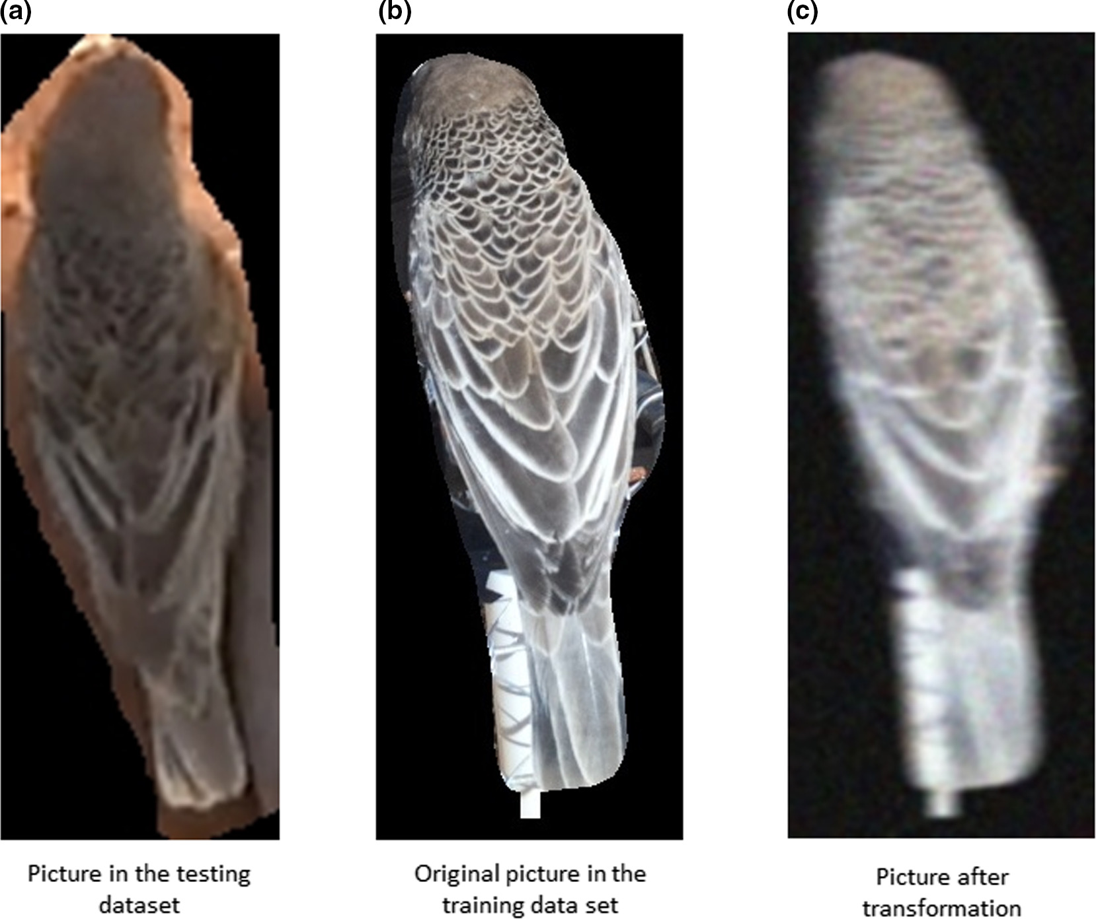
RESULTS

Slide 13
CONCLUSION
The trained Convolutional Neural Network (CNN) model demonstrates impressive performance in accurately classifying bird species, achieving a classification accuracy of over 90% on the test dataset. Confusion matrices reveal minimal misclassifications, particularly among visually similar species. Notable findings include the model's ability to generalize well across diverse bird species and robustness to variations in image quality and environmental conditions. Challenges encountered primarily revolve around fine-tuning hyperparameters for optimal performance and addressing class imbalances within the dataset. Future improvements may involve incorporating additional data augmentation techniques, exploring ensemble learning strategies, and expanding the dataset to encompass a wider range of bird species and environmental contexts.
GITHUB LINK: https://github.com/Mouleesh-K/nm_project

